Slide 1

Junior project Face recognition-based attendance system for primary school and kindergarten kids
Project Group:
Mohammed Rammal U16104253
Reema Al Harbi U17100706
Khuloud Khalid U18105068
Supervisor: Dr Ibrahim Abaker
Examiner: Dr Ahmed Khedr

Slide 2


Table of Contents
INTRODUCTION
MOTIVATION
PROJECT SUMMARY
01
02
03
PROJECT DETAILS
04
05
PROJECT PROGRESS
06
IMPLEMENTATION ISSUES AND CHALLENGES
System Environment
Software Architecture and Design
User Interface Design (Prototype)
07
08
conclusion
09
REFERENCES
Related Existing System

Slide 3
INTRODUCTION

Slide 4
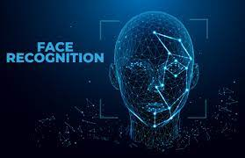
MOTIVATION
There are incidents of children being left behind on school buses that happen every year, which can result in their deaths, especially in summer, due to high temperatures.
With the evolution of technology, we aim to create a system that decreases the number of children dying after being left behind on buses. Since it is easier to take attendance using face recognition than a manual attendance system and to make sure parents feel safe about having their kids riding school buses.

Slide 5
Project summary
The main objective of this project is to provide a system based on Face Recognition (FR) technology. Unlike the manual attendance system, our system will simplify and automates the process of documenting and monitoring the attendance of students. Machine learning algorithms will be adopted for facial recognition to improve the limitations of the present systems, it requires a high-quality camera to record student images, a database, and a mobile application. Our project will be implemented using python and MySQL technologies. This system will be responsible of monitoring student in school buses and make sure that all of the students will reach home safely and on time.

Slide 6




System Environment
PROJECT DETAILS

Slide 7
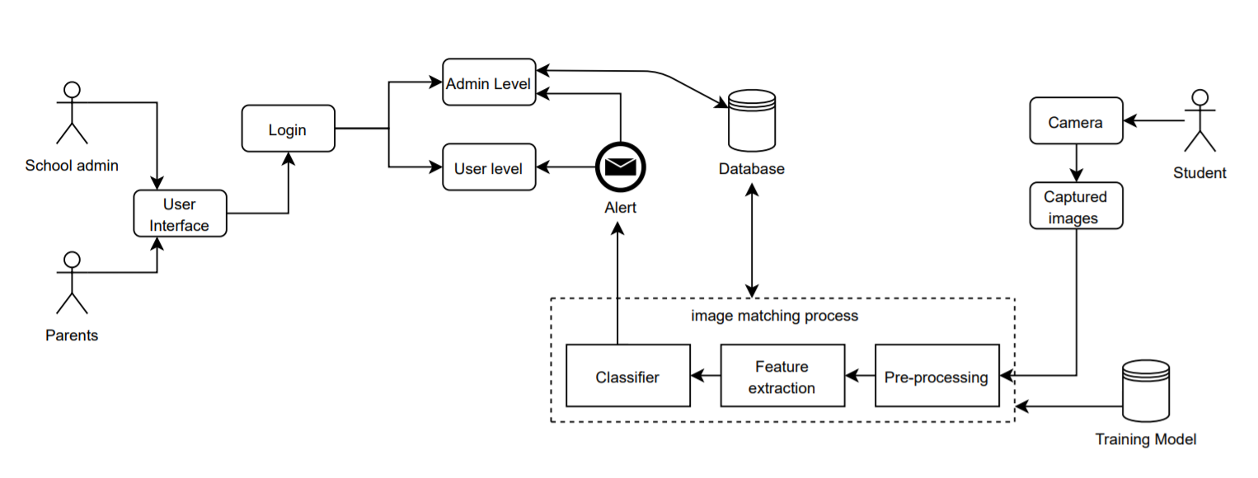
Software Architecture and Design

Slide 8




Architecture Components
Device
Camera
Database
User

Slide 9
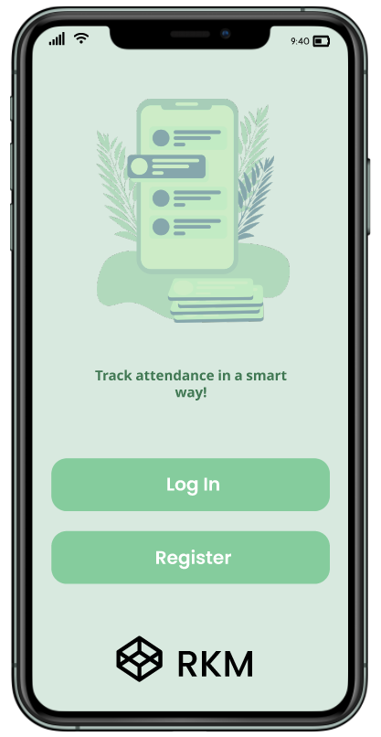
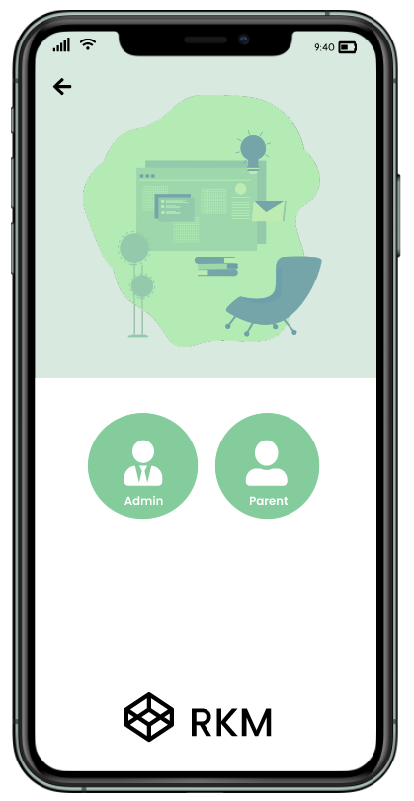
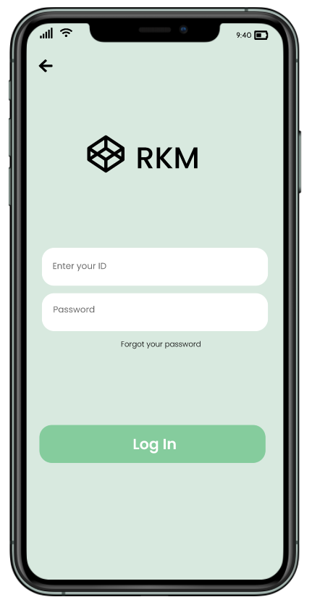
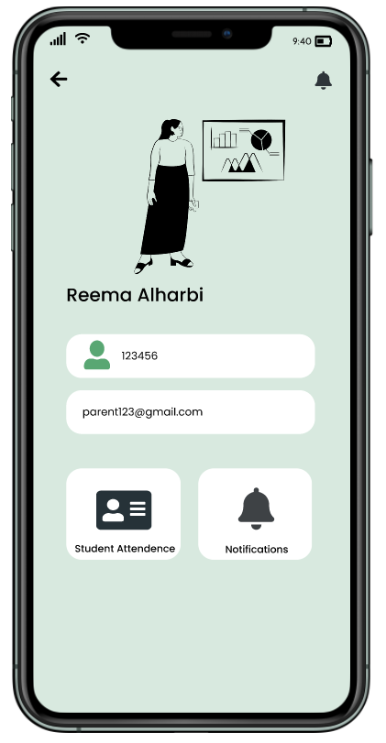
User Interface Design (Prototype)

Slide 10
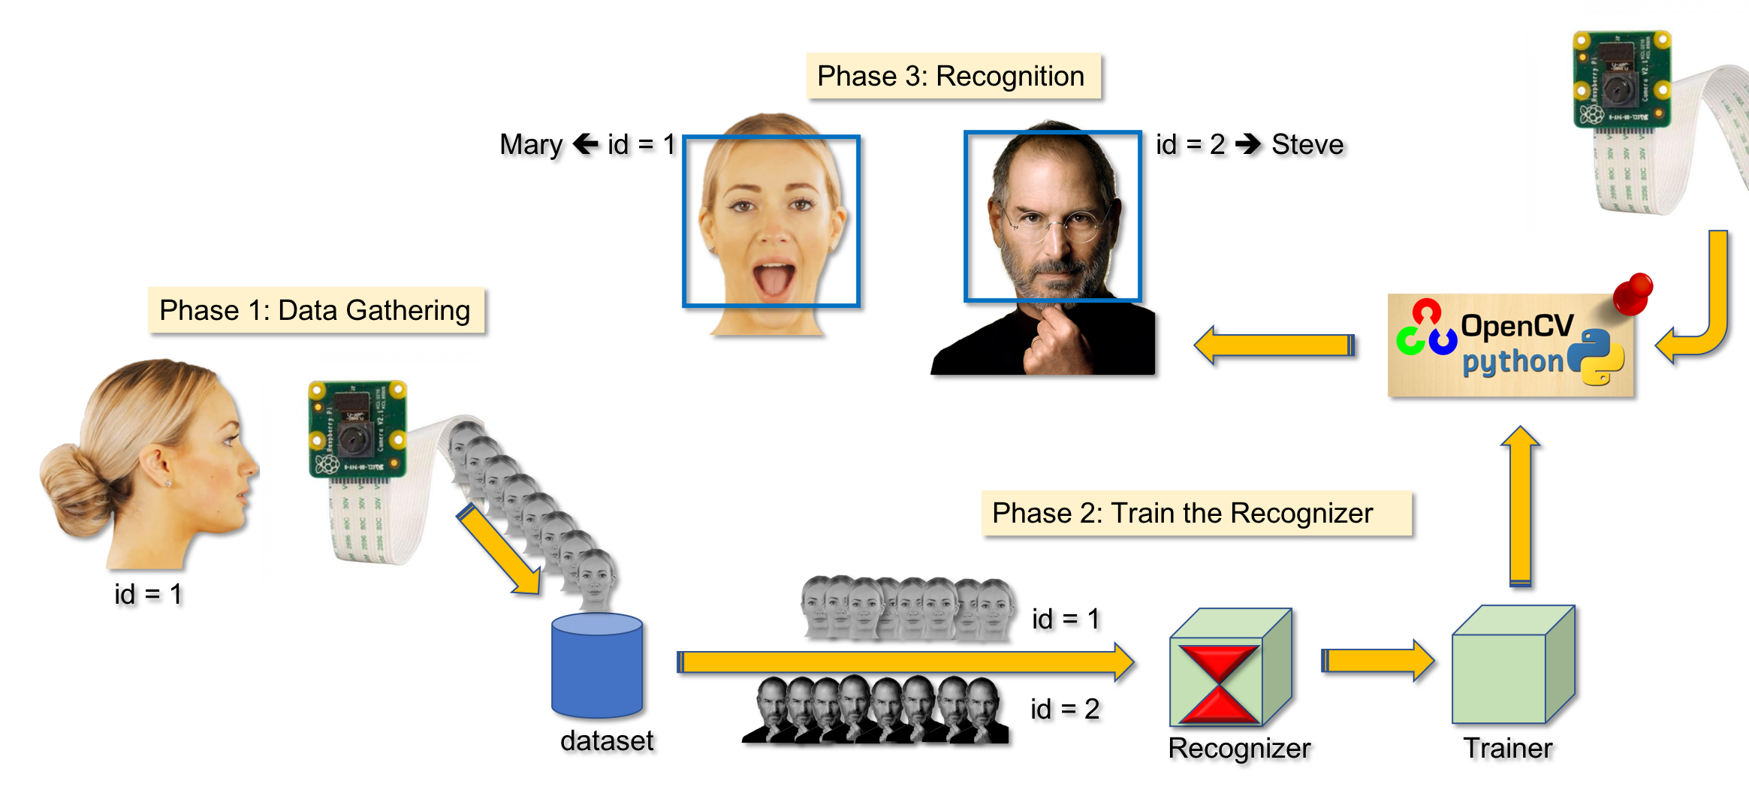
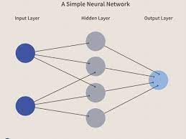
Implementation
A neural network is a series of algorithms that struggle to recognize underlying relationships in a set of data through a process that works the same way the human brain operates.
neural networks refer to systems of neurons, either organic or artificial in nature. It's divided into three parts which is input, hidden, and output.
The database used in developing face recognition systems based on images of human faces captured and processed in preparation for implementing the recognition system.
This technique involves computation of a set of geometrical features such as nose width and length, mouth position and chin shape, etc. from the picture of the face we want to recognize.

Slide 11
Related Existing Systems

Slide 12
The differences between the current system and the proposed system
Current system There is no direct communication A parent should only watch one child at a time • The current system's efficiency was poor. • The device does not keep track of active users. The machine will only alert if you open and check it | Proposed system The system that will be built here is a chat facility and a direct call system. It's a machine that's run from a central location. All local clients are connected to the centralized server vis Lan The centralized server is accessible via LAN to all local parents If the camera is not scanning or is impaired, attendance may be taken using a finger-print. there is a two ways communication between different parents It helps users to identify other users who are logged in.

Slide 13

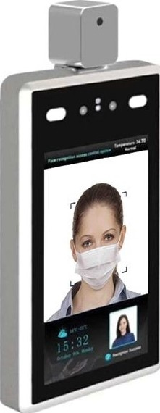

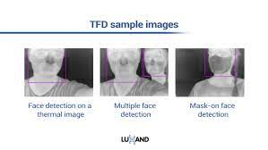
Existing system and proposed system
1- Avalon Face Recognition.
2 - innovatory company has a Smart Face.
3- Thermal Face Detection Face Detection SDK For Thermal Cameras & Systems is available from Lux and.

Slide 14

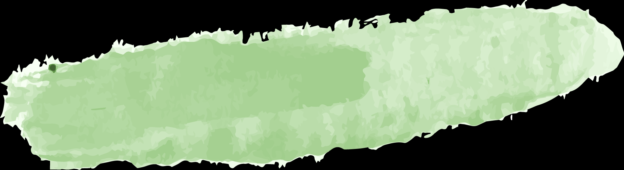


Overall Solution Approach
Parents
Application
School administration
kids
Data base face recognition
Accessible from a range of devices with so many child

Slide 15
conclusion

Slide 16
THANK YOU

